Slide 1


introduction
Made by saad ,Ibraheem,and Haroon.
These slides are going to be about internet safety /cyber bullying

Slide 2
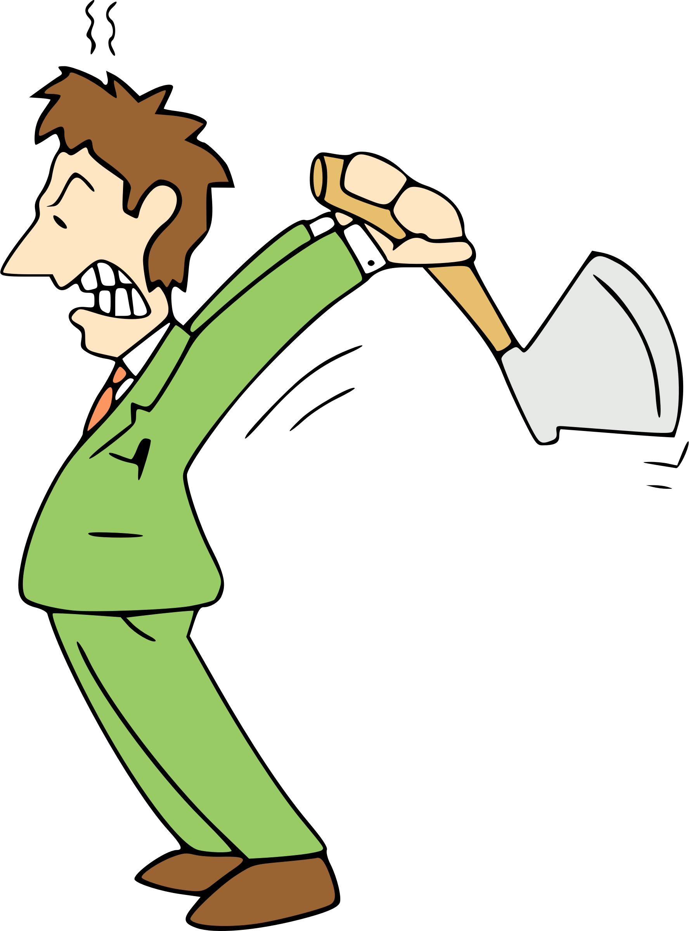


Cyber bullying(internet safety)

Slide 3
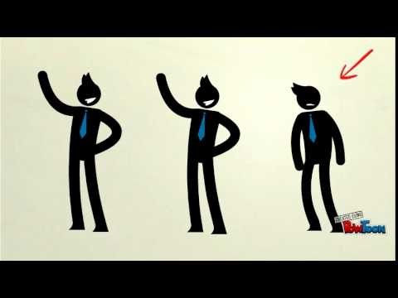
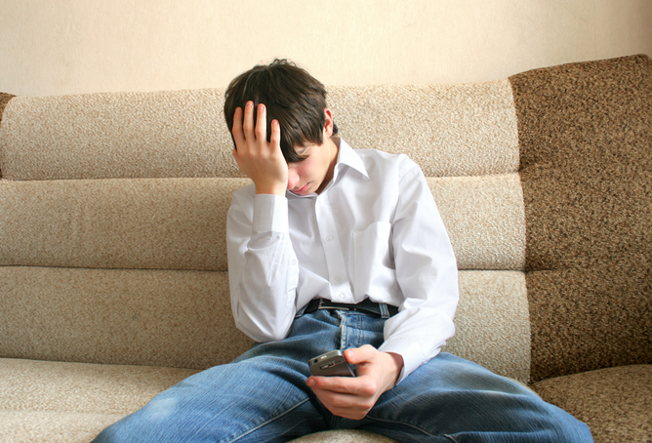
What is cyber bullying?
Cyber bullying is when you are or someone is getting bullied online it is also some insults you , threatens you or tells you make information about them then maybe starts to cyber bully you !
Here is a short video on
cyber bulling to get
a better understanding
of what cyber bullying is

Slide 4
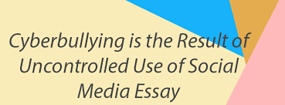
How to prevent cyber bullying
Know its not your fault
Don’t respond or retaliate
Save the evidence
Tell the person to stop
Reach out for help-if the behaviour is really upsetting you
Use available tech tools
Protect your accounts
If someone you know is getting bullied on social media take action!!!

Slide 5

conclusion
Living in the 21st century it is important to know what goes on in the cyber world <hope this presentation helps to understand and learn something new which you might have not known before
THANK YOU FOR WATCHING

