Slide 1
Welcome to our Internet safety powerpoint presentation

Slide 2
Cyber Bullying!
What is cyber-bullying?
Cyber-bullying is the use of electronic devices to harm and bully people around you.
An example of this is by sending threats and intimidating messages.
Cyber-bullying can also take place when a bully spreads rumors and give others false claims of you.

Slide 3
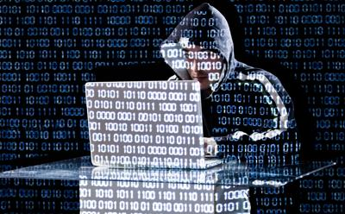
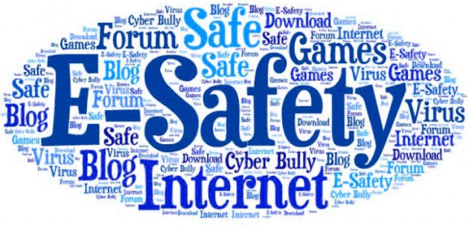
Online Safety
Being safe when using the internet or social apps is extremely important as anyone can hack into your device easily.
How to be safe online:
- Don’t post any personal information online ( like your address, email address or mobile number).
Think carefully before posting pictures or videos of yourself. Anyone can download these pictures and then they won’t be yours anymore.
Don’t be friends with people you don’t know.
- Never give out your passwords!
Currently, snapchat is one of the most dangerous social websites. If you do not turn off your location, anyone can see where you live.
So, basically, you could see where people were living in your country! This is extremely dangerous!

Slide 4
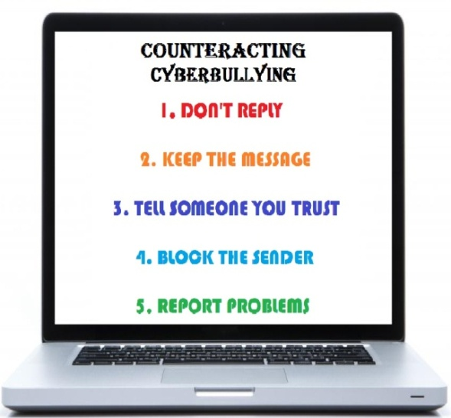
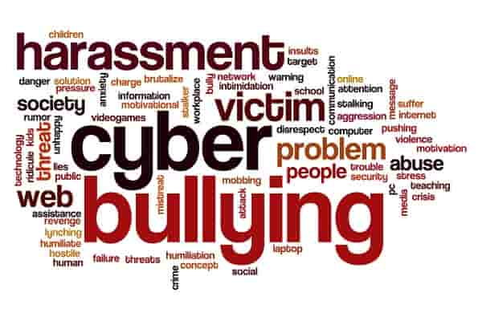
Report Cyber-Bullying!
If you are being bullied online or at school wherever it is, tell a responsible adult who will deal with it properly.
Do NOT let the bully get away with what he/she is doing!

Slide 5
TYPES OF HACKERS !
Black Hat – Also known as crackers, these are the men and women you hear about in the news. They find banks or other companies with weak security and steal money or credit card information. The surprising truth about their methods of attack is that they often use common hacking practices they learned early on.
WHITE HAT –The term ’white hat’ in internet slang refers to an ethical computer hacker ,or a computer security expert, who specializes in penetration testing and in other testing methodologies that ensures other security of an organization’s information systems.

Slide 6
CONCLUSION
LIVING IN THE 21ST CENTURY WE FACE MANY HIDDEN CYBER ISSUES ON A DAILY BASIS.
HOPE THIS PRESENTATION HELPS YOU LEARN SOMETHIMG NEW
THANKS FOR WATCHING

